Slide 1
Introduction to Data Analysis

Slide 2
DATA VISUALIZATION BASICS
Patrick Boily Data Action Lab | uOttawa | Idlewyld Analytics
pboily@uottawa.ca
[with files from Stephen Davies | DAVHILL]

Slide 3

THE (MESSY) ANALYSIS PROCESS
Objective/
Rationale
Utilization and Decision Support
Data Collection
Data Exploration
Infrastructure and Data Management
Data Preparation
Modeling and Analysis
Communication

Slide 4
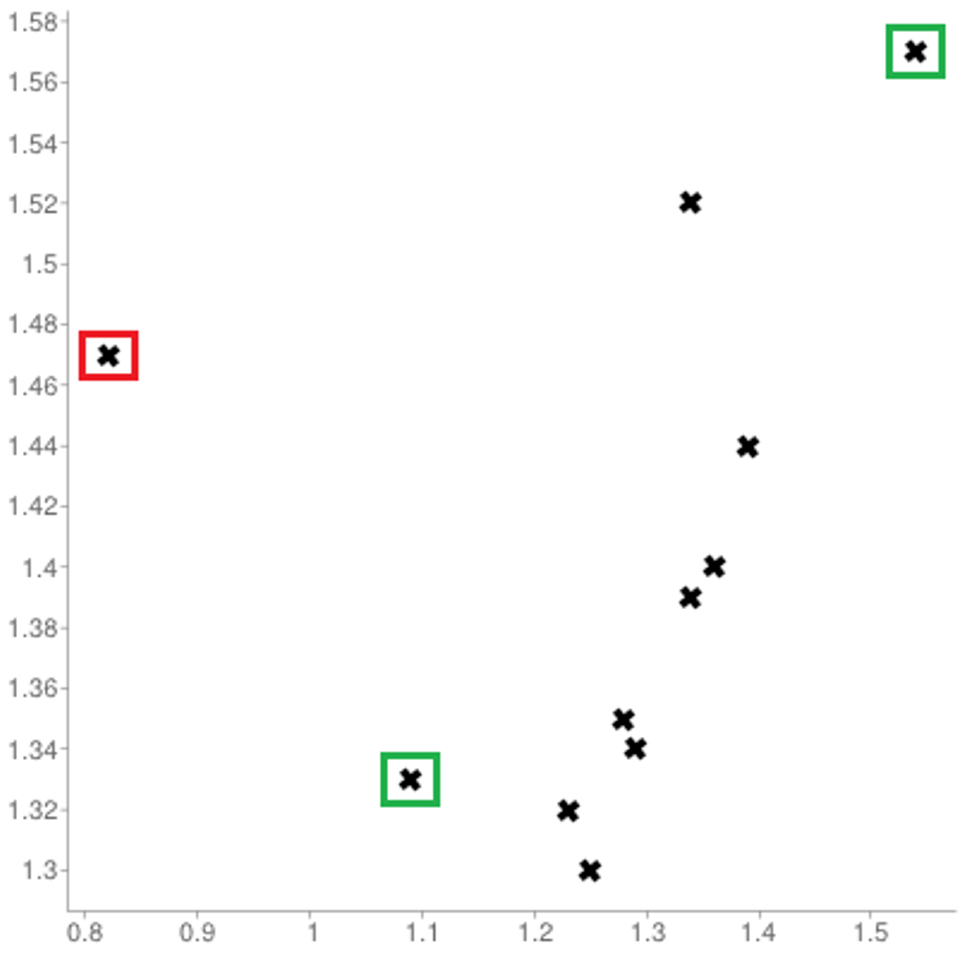
[Personal dataset]
Customers served at counter (per minute)
Customer arrivals at counter (per minute)

Slide 5
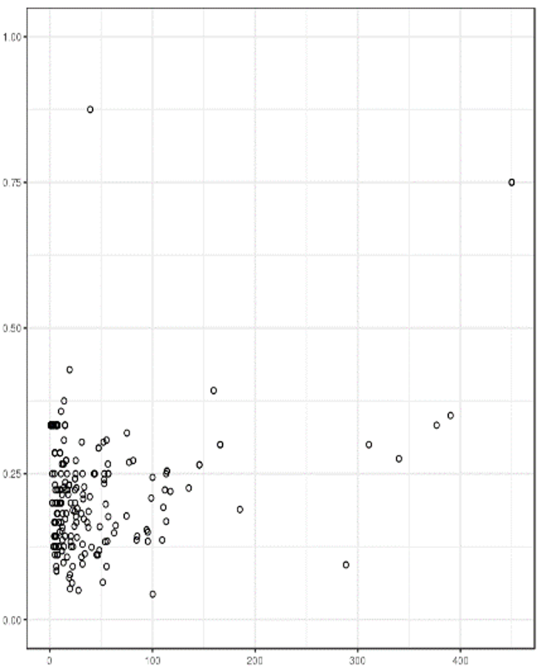
REPRESENTING OBSERVATIONS
[http://promise.site.uottawa.ca/SERepository/datasets/cm1.arff]
2 variables can be represented by position in the plane.
Additional factors can be depicted through:
size
color
value
texture
line orientation
shape
(motion?)
NASA CM1 Dataset (subset)

Slide 6
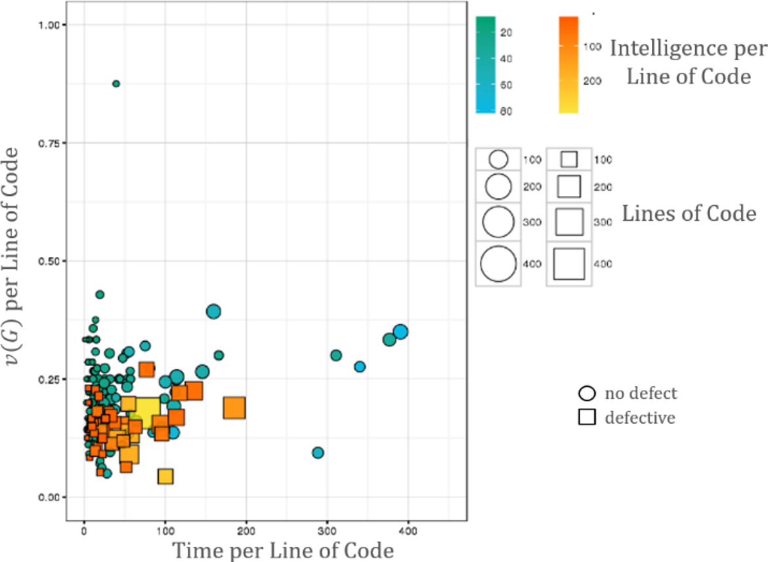
[http://promise.site.uottawa.ca/SERepository/datasets/cm1.arff]
NASA CM1 Dataset (subset)
colour
size
shape
position

Slide 7
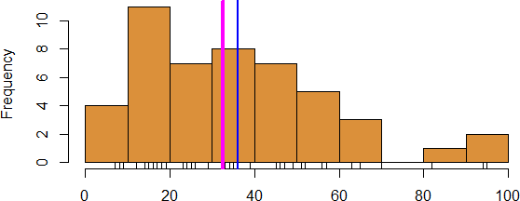
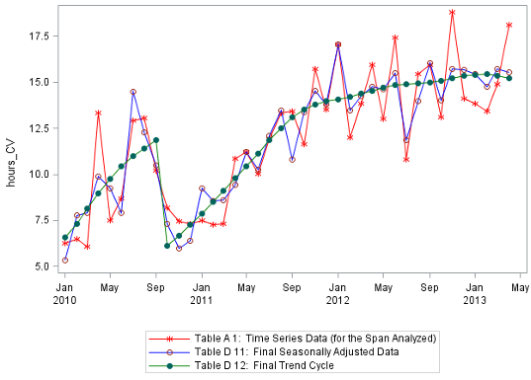
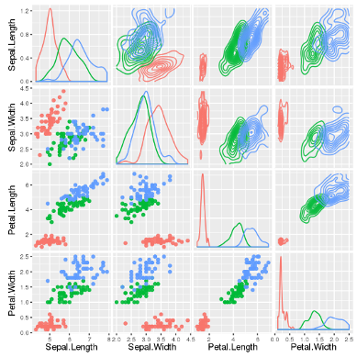
WORKHORSE VISUALIZATIONS
Line Chart/Rug Chart/Number Line
Histogram
Line Graph
Boxplot
Bar Chart
Scatterplot

Slide 8
FUNDAMENTAL PRINCIPLES OF ANALYTICAL DESIGN
[E. Tufte, Beautiful Evidence]
Reasoning and communicating our thoughts are intertwined with our lives in a causal and dynamic multivariate Universe.
Symmetry to visual displays of evidence: consumers should be seeking exactly what producers should be providing, namely
meaningful comparisons
causal networks and underlying structure
multivariate links
integrated and relevant data
honest documentation
primary focus on content
Is the point getting across? Is the message being conveyed?

Slide 9
A WORD ABOUT ACCESSIBILITY
[http://dataphys.org/list/]
Charts cannot usually be translated to Braille. Describing the features and emerging structures in a visualization is a possible solution… if they can be spotted.
Analysts must produce clear and meaningful visualizations, but they must also describe them and their features in a fashion that allows all to "see" the insights. This requires analysts to have “seen” all the insights, which is not always possible.
Conditions: colourblindness, low vision, motor impairment, cognitive disability, ADHD, etc.
Best Practices: high contrast text/elements, zoom/magnifications, keyboard navigation, assistive design, short summaries, undo/redo functionality, etc. [F. Elavsky]

Slide 10
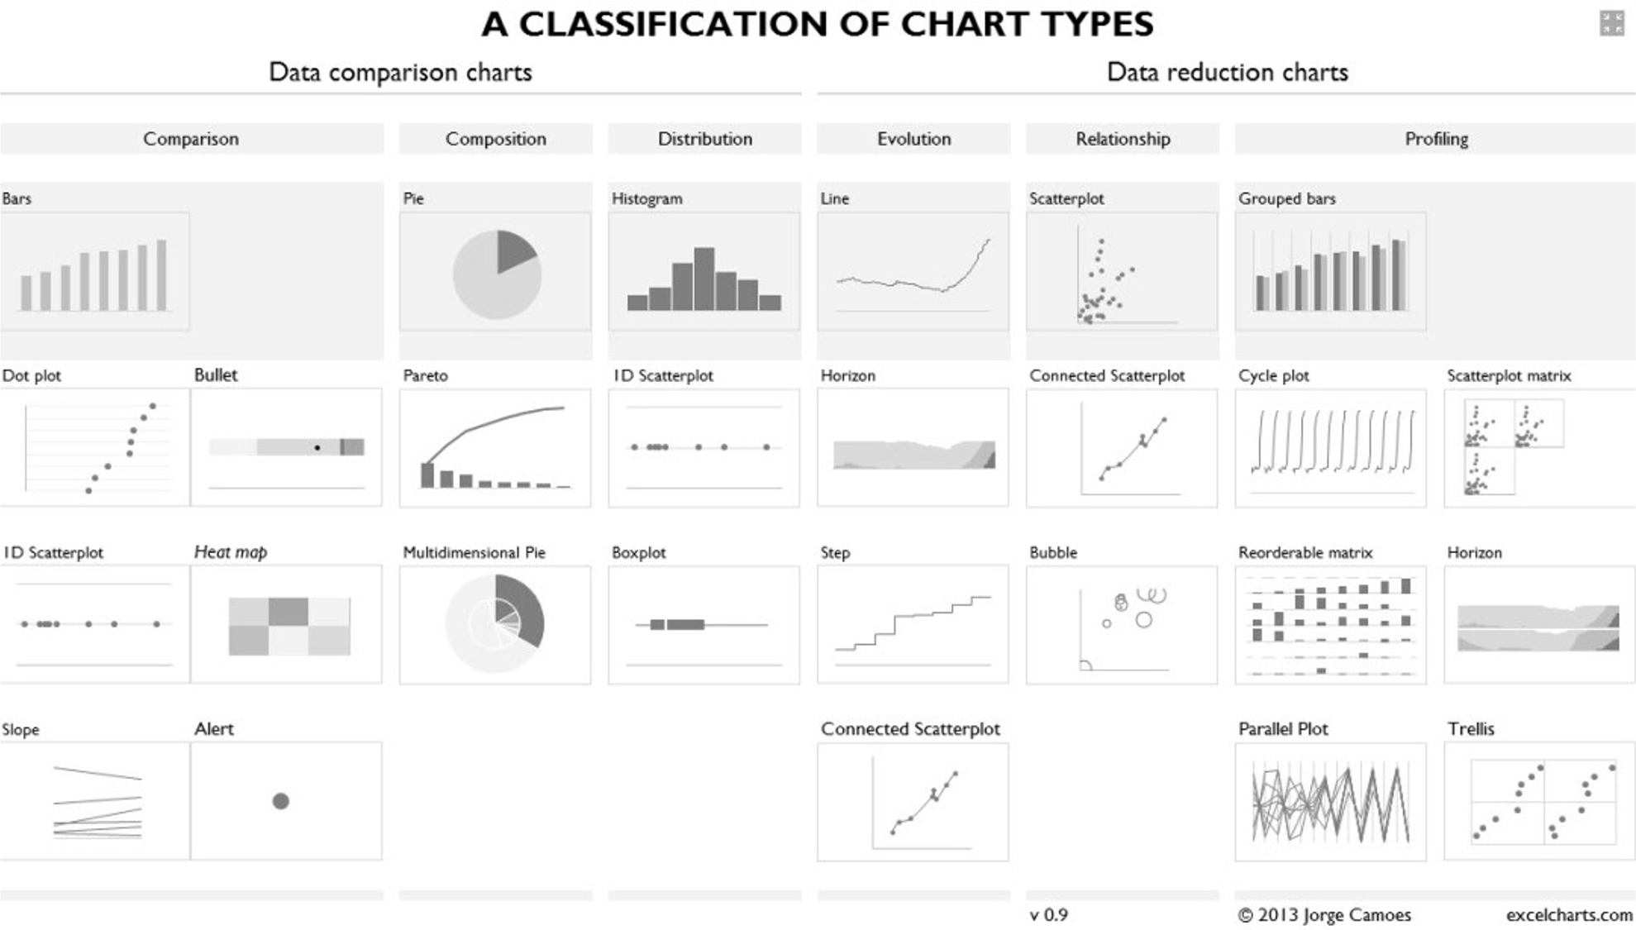

Slide 11
CHART TYPES
Simple Text and Tables
Scatterplot
Line Chart
Bar Charts
Stacked Bar Charts
100% Bar Charts
Area Charts
Treemaps
Gauge Charts
Heatmaps and Choropleth Maps
Geographical Maps
Parallel Coordinates
Chernoff Faces
Word Clouds
Network Diagrams
Dendrograms and Trees
Sparklines
Interactive Charts
Small Multiples
etc.

Slide 12
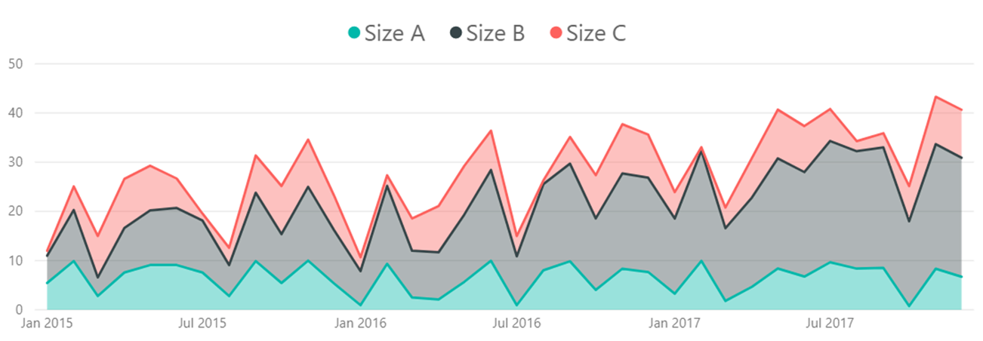
CHARTS TO AVOID
AVOID (?) anything with an arc (except gauge charts): pie, donut, etc: human brains have a hard time comparing arcs -- without labels, how different are Steve & Bob?
AVOID 3D charts: it is difficult to compare them visually (and they add too much clutter).
AVOID stacked area charts: way too confusing.

Slide 13
TAKE-AWAYS
Effective data visualizations provide insights and facilitate understanding.
The basic principles can guide your visualization design and consumption.
Be creative but keep your data and your representations honest.
Be mindful of attempts to distort trends and conclusions with flashy visuals.
Data and code should be made available along with the displays.

Slide 14
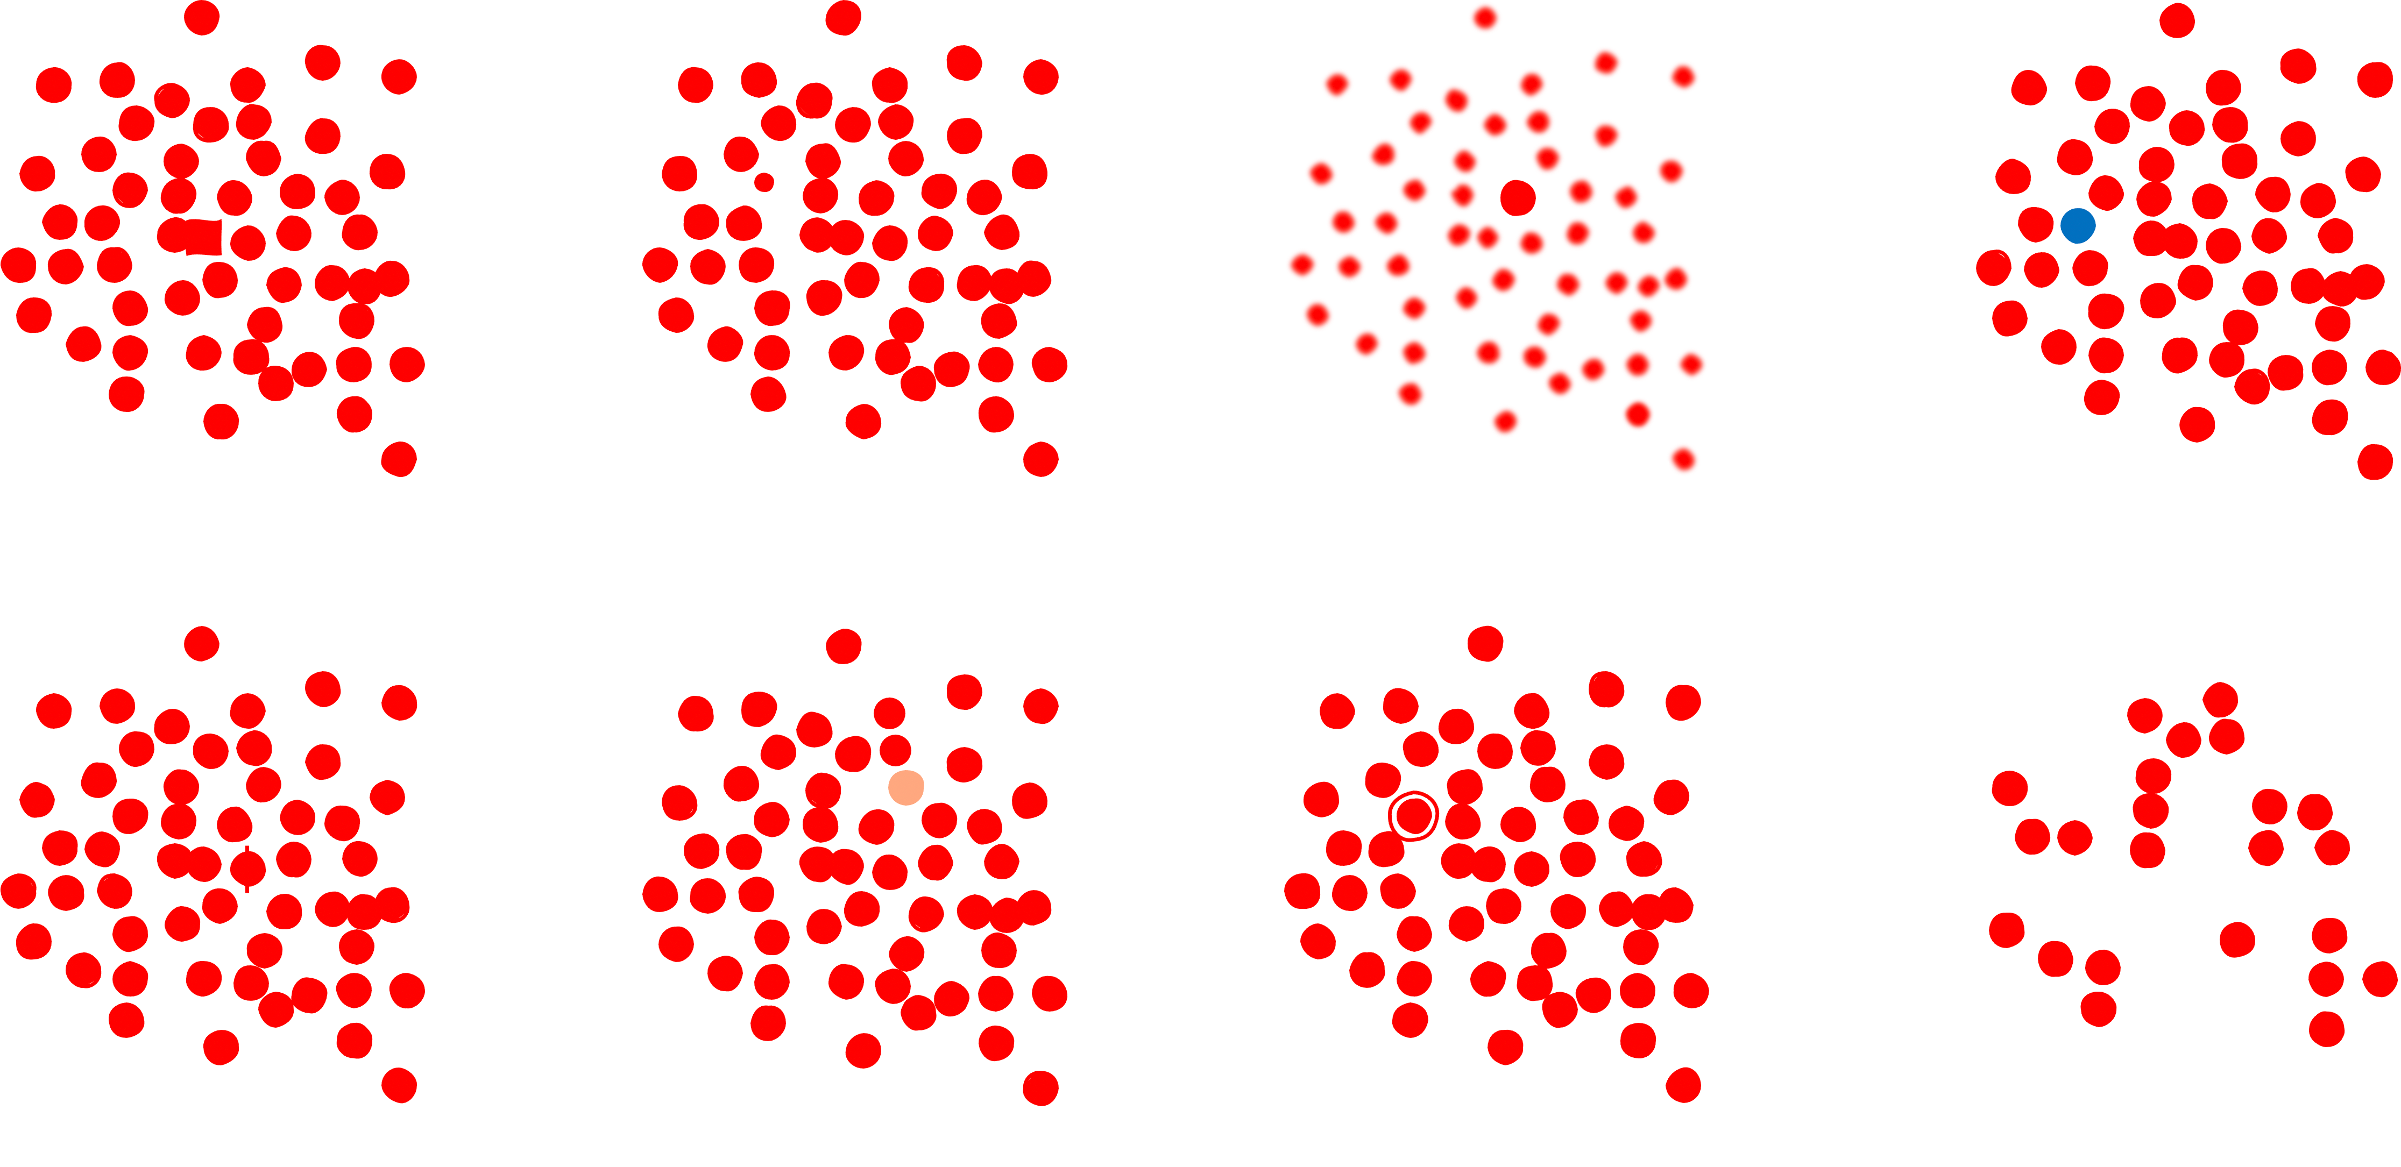
PRE-ATTENTIVE FEATURES
[P. Boily, S. Davies, J. Schellinck, The Practice of Data Visualization]
shape
size
sharpness
color/hue
markings
intensity/value
enclosure
numerosity

Slide 15
DECLUTTERING
CLUTTER IS THE ENEMY!
every element on a page adds cognitive load
identify anything that isn’t adding value and remove
think of cognitive load as mental effort required to process information (lower is better)
Tufte refers to the data to ink ratio – “the larger the share of a graphic’s ink devoted to data, the better”
in Resonate, Duarte refers to this as “maximizing the signal-to-noise ratio” where the signal is the information or the story we want to communicate.

Slide 16
DECLUTTERING
Use Gestalt Principles to organize/highlight data in a chart.
Align all the elements (graphs, text, lines, titles, etc.)
DON’T rely on eye, use position boxes and values
Charts:
remove border, gridlines, data markers
clean up axis labels
label data directly
Things
More things

Slide 17
DECLUTTERING
Use consistent font, font size, colour and alignment.
Don’t rotate text to anything other than 0 or 90 degrees.
Use white space:
margins should remain free of text and visuals
don’t stretch visuals to edge of page or too close to other visuals
think of white space as a border

Slide 18
CHART SIZES
Assuming that the chart has been decluttered:
things of equal importance size similarly;
other things scale to importance.
As one rarely puts more than 3-4 charts on a page, there are limited size options.
Perennial exception: geographical maps may require more space.

Slide 19



COLOUR SCHEMES
[http://www.deanenettles.com/webexamples/colorexamples]
Split-Left/Right Complementary
Analogous
Colour Diad
Colour Triad
Colour Tetrad
Achromatic
Monochromatic
Complementary
Split complementary

Slide 20
COLOUR SCHEMES
When it comes to colour, less is more: use it sparingly (graphic designers are taught to “get it right, in black and white”).
Based on the Gestalt Principles, monochrome schemes can be particularly effective.
When appropriate, pick scheme based on corporate identity (this maximizes buy in).
Create a template (and stick to it).
Upload images to see what charts look like in various flavours of colour-blindness:
https://www.color-blindness.com/coblis-color-blindness-simulator (there are other tools)

